Slide 1

6th Summer School on Theory, Mechanisms and Hierarchical Modelling of Climate Dynamics: Artificial Intelligence and Climate Modelling

Slide 2
Thanks to all Directors: Serafina Di Gioia, Franco Molteni,
Riccardo Farneti, Adrian Tompkins, and most of all to all
participants and speakers, support, and also especially to
Activity Secretary Viktoriya Lvova!

Slide 3
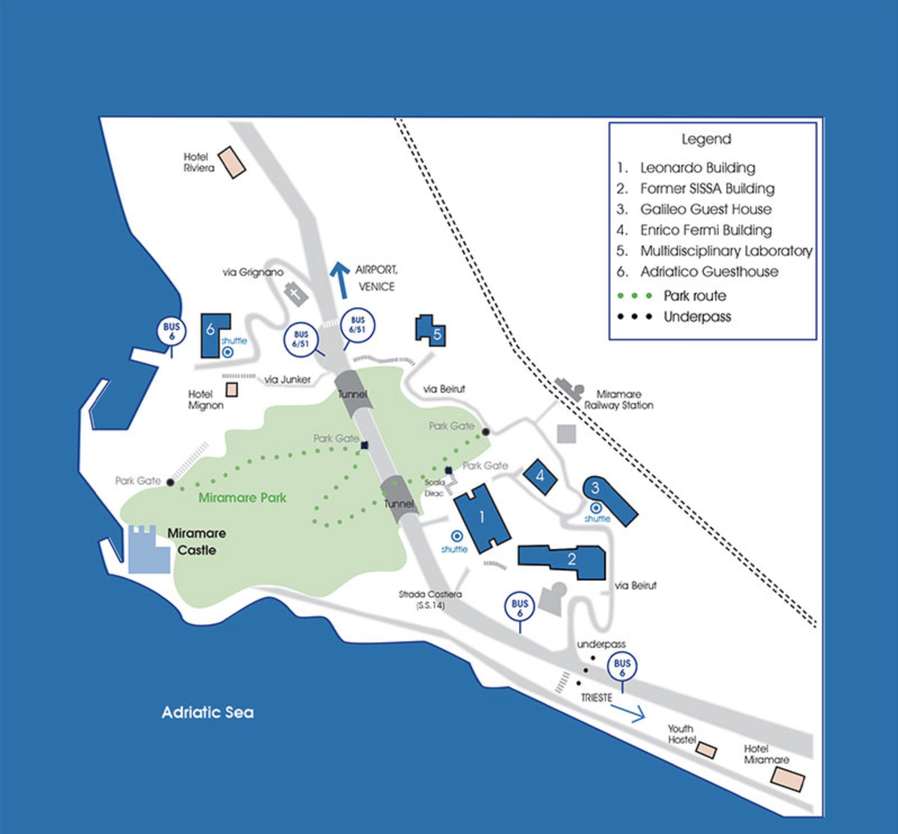

We are here:
Adriatico Guesthouse
All other important
stuff is here:
Fermi Building
Leonardo Building

Slide 4
Welcome Reception: Wednesday, 7 May, 18:30, in
Adriatico Cafeteria.
B) Poster Sessions: 1 Online: Thursday, 8 May, 14:00-15:30,
2 in person: Wednesday, 7 May, 17:00-18:30, Monday, 12 May,
17:00-19:00
C) All information related to the Activity is on:
https://indico.ictp.it/event/10832/overview
D) ICTP Website for further information: http://www.ictp.it
E) So, let’s have a nice meeting and thanks to all of you for
participating!!!!!

Slide 5
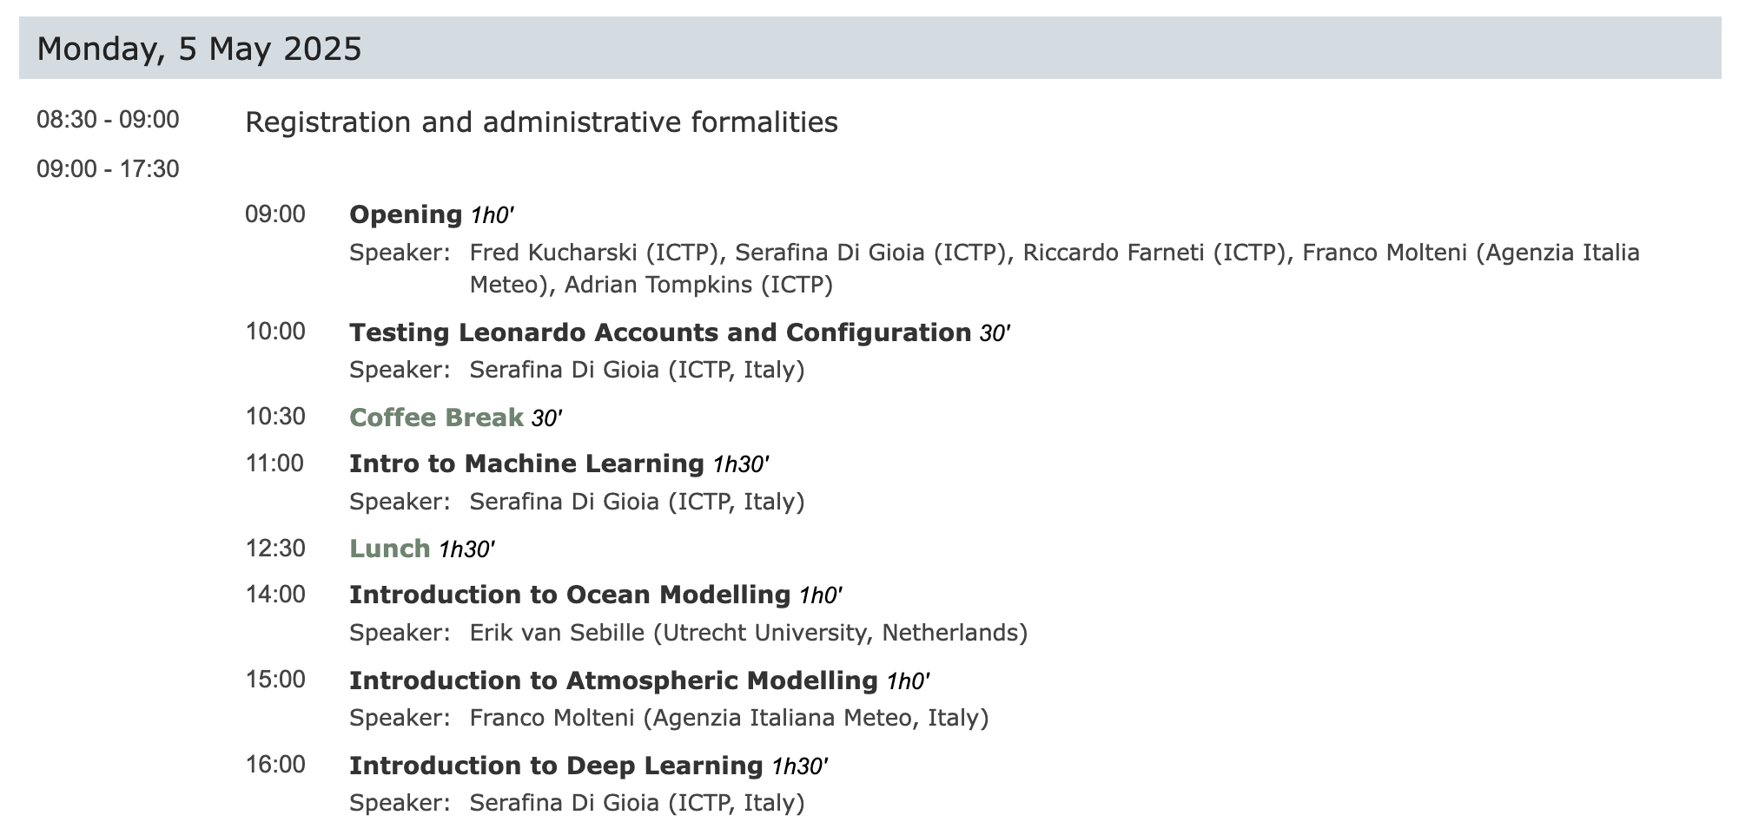

Slide 6
